Slide 1
Nutrition agent
CAPSTONE PROJECT
Presented By
Student name : Athira Pillai
College Name : Vijaya Vittala Institute Of Technology
Department : CSE in AIML

Slide 2
OUTLINE
Problem Statement
Technology used
Wow factor
End users
Result
Conclusion
Git-hub Link
Future scope
IBM Certifications

Slide 3
Problem Statement
The Challenge - In an era where health awareness is growing, individuals increasingly seek personalized nutrition guidance. However, most existing tools provide generic diet plans, lack real-time adaptability, and fail to consider a person's holistic lifestyle, cultural preferences, allergies, and evolving health conditions. Furthermore, dieticians and nutritionists face limitations in scaling personalized consultations due to time and resource constraints.
Proposed Solution:Generative AI presents a groundbreaking opportunity to revolutionize this space by enabling an intelligent, interactive, and adaptive virtual nutrition assistant. By leveraging natural language processing (NLP), multimodal understanding, and large-scale dietary databases, an AI-powered assistant can generate dynamic meal plans, recommend smart food swaps, and explain nutritional choices—all tailored to the individual.

Slide 4
Technology used
IBM cloud lite services
Natural Language Processing (NLP)
Retrieval Augmented Generation (RAG)
IBM Granite model

Slide 5
IBM cloud services used
IBM Cloud Watsonx AI Studio
IBM Cloud Watsonx AI runtime
IBM Cloud Agent Lab
IBM Granite foundation model

Slide 6
Wow factors
This agent involves involves emphasizing unique, futuristic, or highly valuable capabilities that differentiate it from standard applications.
Unique features:
Built on IBM Cloud for Enterprise-Grade Trust
Agentic Behavior with Autonomy
Seamless Integration with Enterprise and Consumer Apps
Agentic Personalization at Scale
Dynamic Nutrient Forecasting
Explainable AI Recommendations

Slide 7
End users
Individual consumers
Health care sector
Fitness and Lifestyle Platforms
Wellness Programs

Slide 8
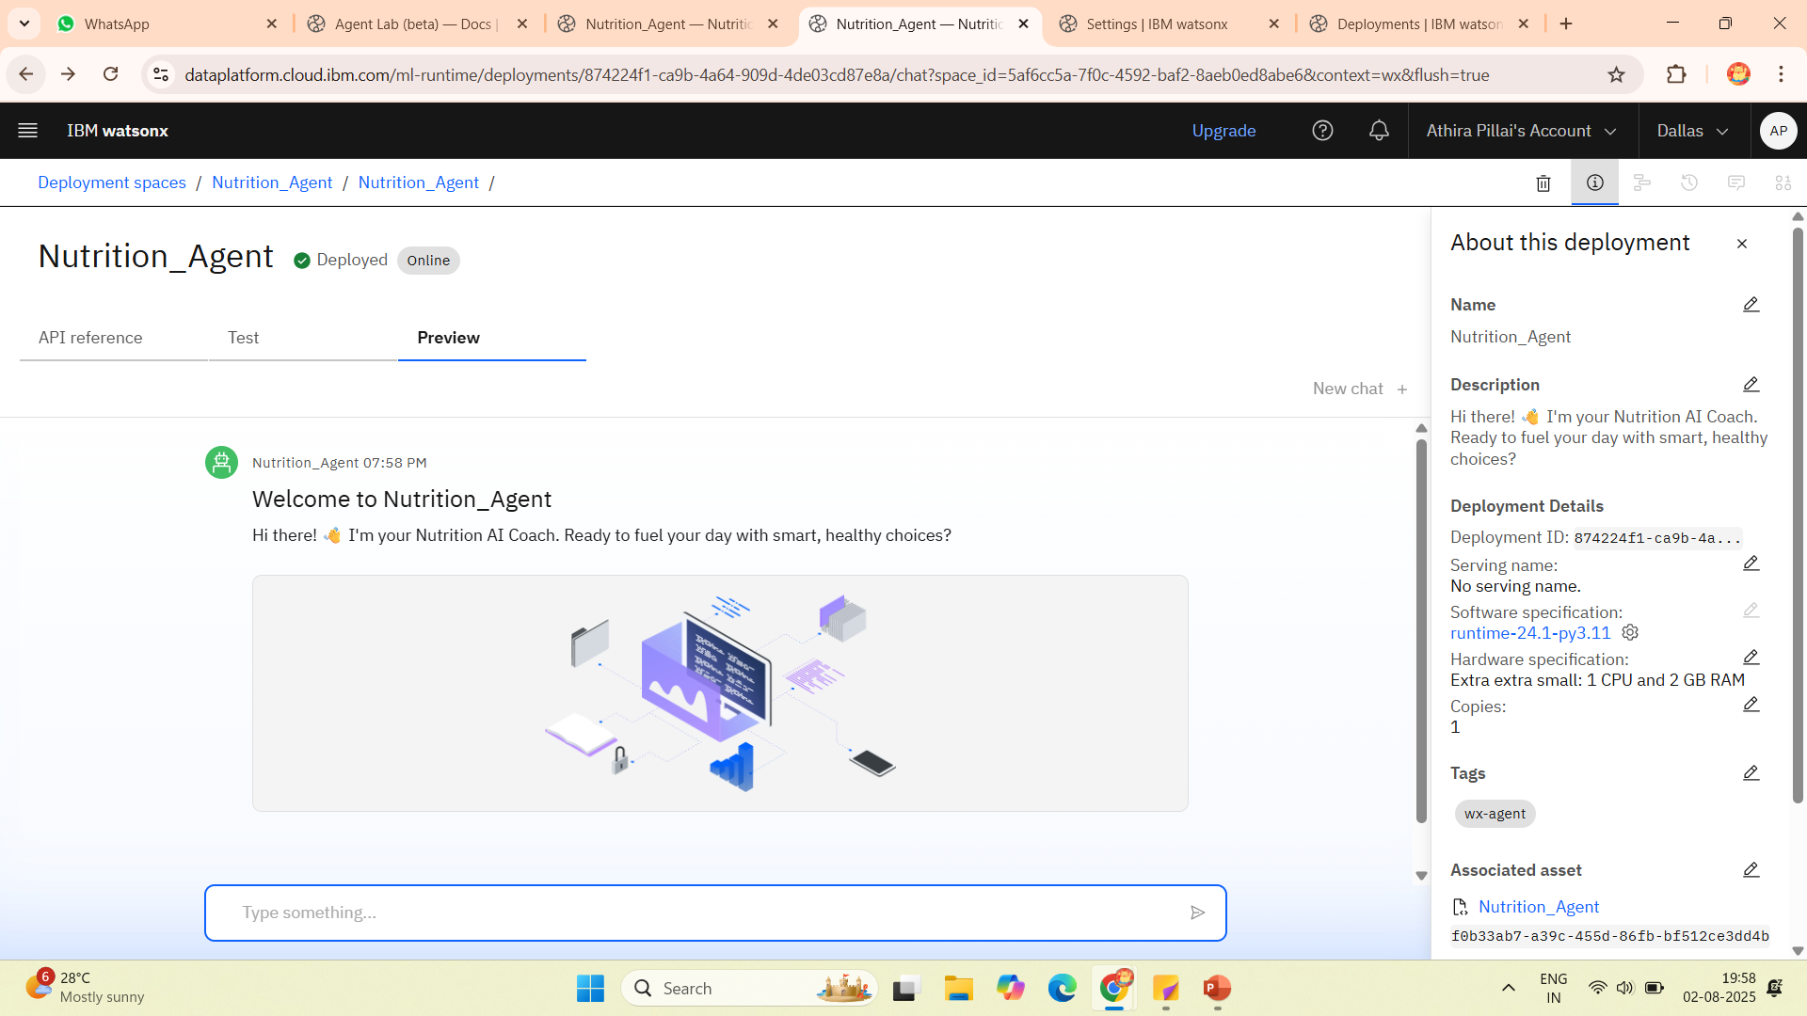
Results

Slide 9
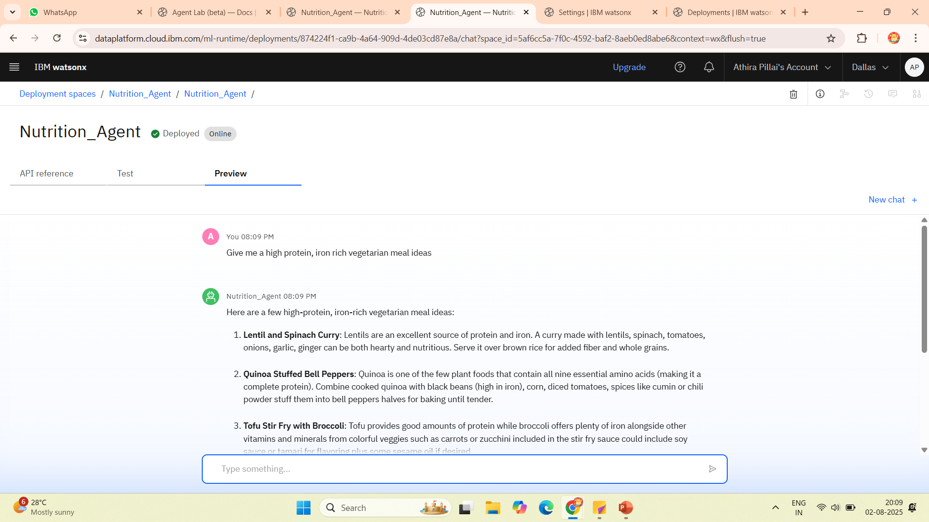
Results

Slide 10
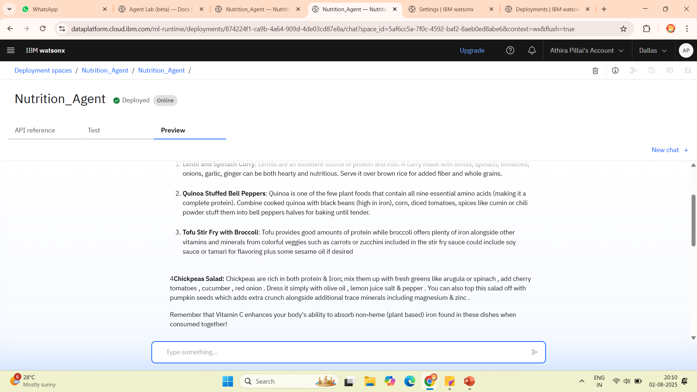
Results

Slide 11
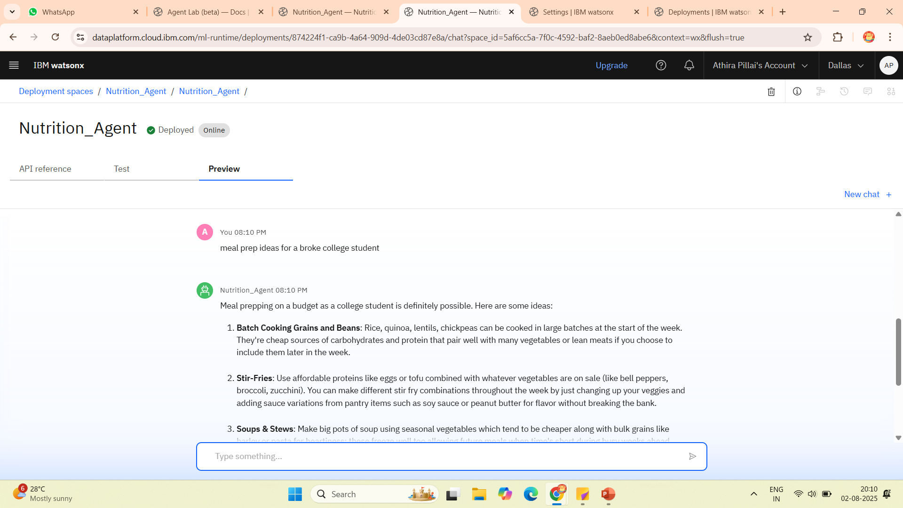
Results

Slide 12
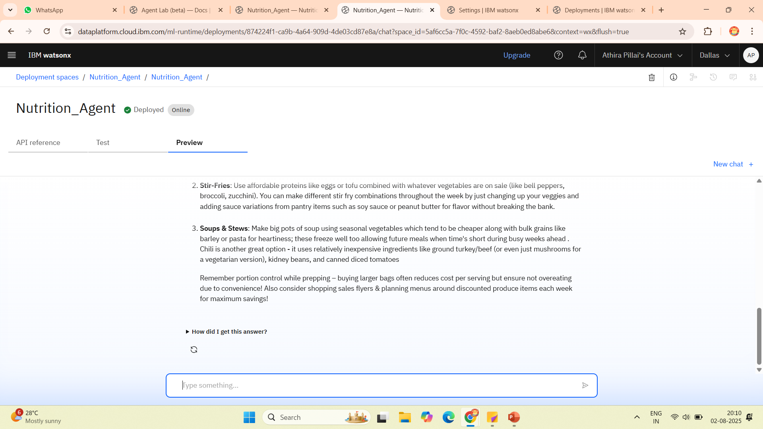
Results

Slide 13
Results
⭐️The AI gathers user data from multiple sources
⭐️Using IBM Watson and foundation models:
Natural Language Processing (NLP): Interprets medical texts, user queries
Predictive modeling: Forecasts health risks and nutritional deficiencies
Optimization engine: Matches dietary needs to best foods/meals
Agent logic: Uses planning and memory (like LangChain-style agents) to act on behalf of the use
⭐️The AI generates:
Custom daily meal plans
Grocery shopping lists (linked to local stores)
Supplement suggestions
Calorie/macronutrient breakdowns

Slide 14
Conclusion
The agent delivers highly tailored meal plans, grocery lists, and lifestyle nudges that adapt in real time to each user’s habits, goals, and preferences.
The AI handles the “what, when, and how” of daily nutrition.
It intelligently using inputs like habits, preferences, and activity, the agent transforms raw data into meaningful food choices, without user overwhelm.

Slide 15
Future scope
Integration with smart kitchens
Voice-first nutrition assistants on devices like Alexa, Siri, or in cars
Augmented reality (AR) meal planning
Emotion-aware food recommendations based on mood or stress levels
AI-guided food discovery personalized by taste, culture, and location
Sustainability tracking — AI suggests eco-friendly or low-waste diets
Social + gamified wellness ecosystems with shared meal plans and AI coaching

Slide 16
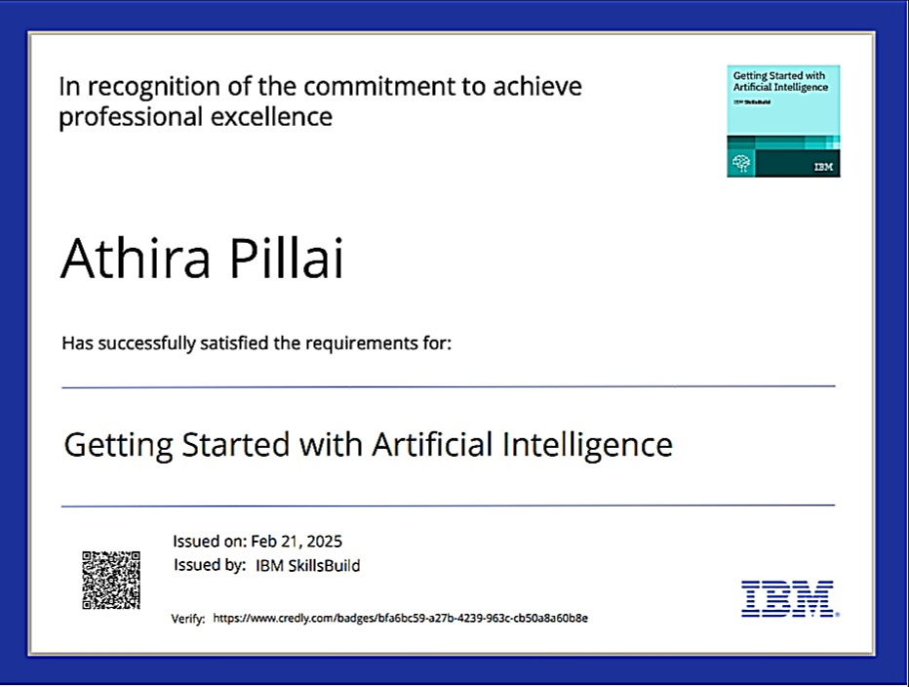
IBM Certifications

Slide 17
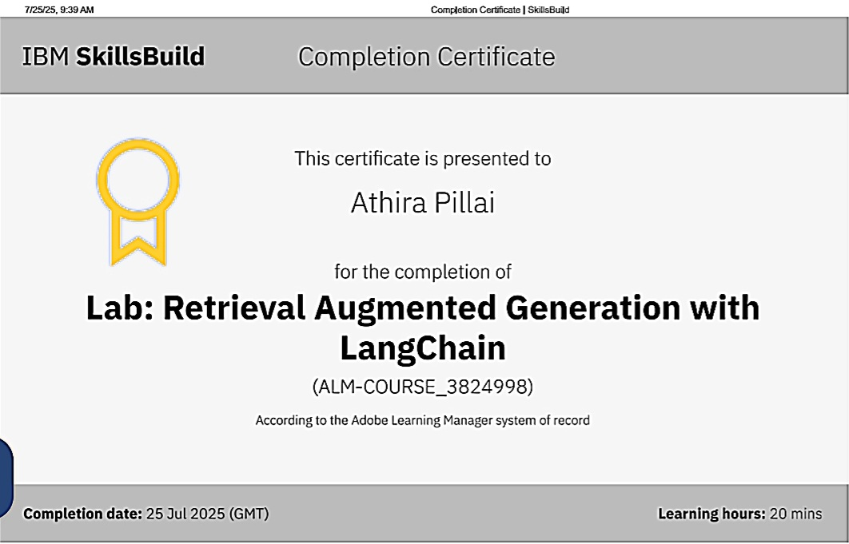

Slide 18
Git hub link : https://github.com/Athira-pillai/Nutrition-Agent.git

Slide 19
GitHub Link
https://github.com/Athira-pillai/Nutrition-Agent/blob/main/README.md

Slide 20
THANK YOU

